Slide 1
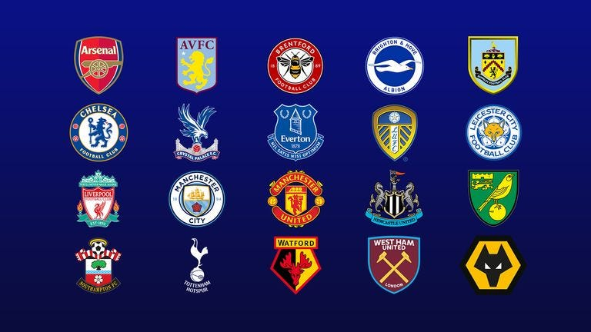
Strategic Sponsorship Evaluation
English Premier League Team Selection for Airline Brand Partnership
Part A:
Research and give a ballpark range of what each EPL team listed in the Excel might charge as a sponsorship fee per annum for this category (for non-jersey or stadium sponsorship)
EPL Team | Sponsorship Fee Per Annum
Manchester United | $36 million - $52 million
Liverpool | $28 million - $40 million
Manchester City | $27 million - $38 million
Newcastle United | $7 million - $14 million
Arsenal | $14 million - $25 million
Chelsea | $7 million - $21 million
Tottenham Hotspur | $21 million - $35 million
Everton | $7 million - $14 million
West Ham | $7 million - $21 million
Manchester United's iconic Old Trafford, with its rich history and extensive branding opportunities, has seen a solid 16% average growth in stadium sponsorship, reflecting its enduring appeal to sponsors.
Liverpool, buoyed by recent successes and a fervent global fanbase, enjoys a 17% average growth rate in stadium sponsorship, amplified by the exposure provided by hosting numerous prestigious matches and events at their stadium.
Manchester City's ascent to success, driven by strategic investments and on-field achievements, is mirrored in their stadium sponsorship fees, boasting the highest average growth rate at 19%, bolstered by modern facilities and a rapidly expanding fanbase.

Slide 2

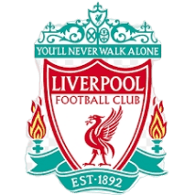
Part B:
What would be your top 3 choice of teams for the airline brand to partner with and why? Which questions and which metrics would be your core focus to help rationalize the decision?
Choice One | Manchester United
Longer history of success and Largest global fanbase among EPL clubs.
Rich history with numerous domestic and international titles.
Strong brand recognition and commercial appeal.
Extensive social media presence and engagement.
Recent performance has been inconsistent compared to historical standards.
Most popular team with over 182 million online fans and 20 English top-flight titles.
Brief Justification:
Metrics like social media reach and fan engagement underscore its appeal, ensuring maximum brand exposure across diverse markets.
Choice Two | Liverpool
Significant global following and passionate fanbase over 114 million.
Recent success in the Premier League and UEFA Champions League.
Strong brand and history, especially in Europe.
Highly engaging on social media platforms.
Somewhat overshadowed by historical rivals in certain markets.
Second all-time with 19 titles, just one behind Manchester United.
Brief Justification:
Metrics such as recent on-field success achievements, fan engagement, and social media influence highlight its suitability for enhancing brand visibility and audience connection, particularly in key regions.

Slide 3

Part B:
What would be your top 3 choice of teams for the airline brand to partner with and why? Which questions and which metrics would be your core focus to help rationalize the decision?
Choice Three | Manchester City
Rapidly growing global fanbase over 116 million due to recent success.
Consistent performance and titles in recent years.
Modern, attacking style of play.
Strong digital presence and marketing.
Comparatively younger history of success.
Lesser brand recognition compared to United and Liverpool historically.
Won the 2023/24 season, bringing their total to 10 titles, including four consecutive titles.
Brief Justification:
Metrics like digital presence and sponsorship portfolio analysis showcase its potential to amplify brand messaging and reach diverse audiences, aligning with the airline's goals.
Questions:
What is the size and demographics of the club’s fan base?
What is the media and digital reach of the club?
What is the historical and projected attendance at the stadium?
What are the current and potential commercial partnerships and sponsorships?
What are the unique selling points (USPs) of the stadium and the club?
Key Metrics:
Team Performance - league standings and titles won
Fan Base Size and Engagement - Social media followers and engagement like number of tickets sold
Media Reach - TV viewership ratings
Sponsorship Value - Value and duration of existing deal

Slide 4
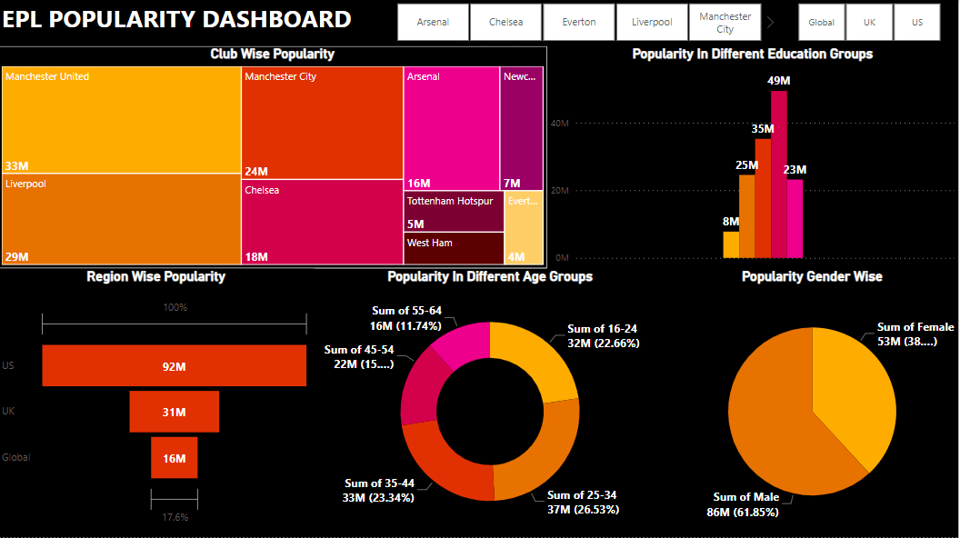
Part C:
Build a single dashboard to
be able to filter and view by
Club
Market / Region
Gender
Age
Education
Top 3 Teams: Manchester United, Liverpool, and Manchester City are the most popular teams.
Education Group: Most fans have an undergraduate degree, followed by upper secondary and post-secondary vocational education.
Region: The US leads with 92 million fans, followed by the UK with 31 million, and 16 million globally.
Age Group: The 25-34 age group is the largest, with 37 million fans, followed by 35-44 with 33 million, and 16-24 with 32 million.
Gender:61.85% of the fanbase is male, while 38.15% is female.

